Slide 1
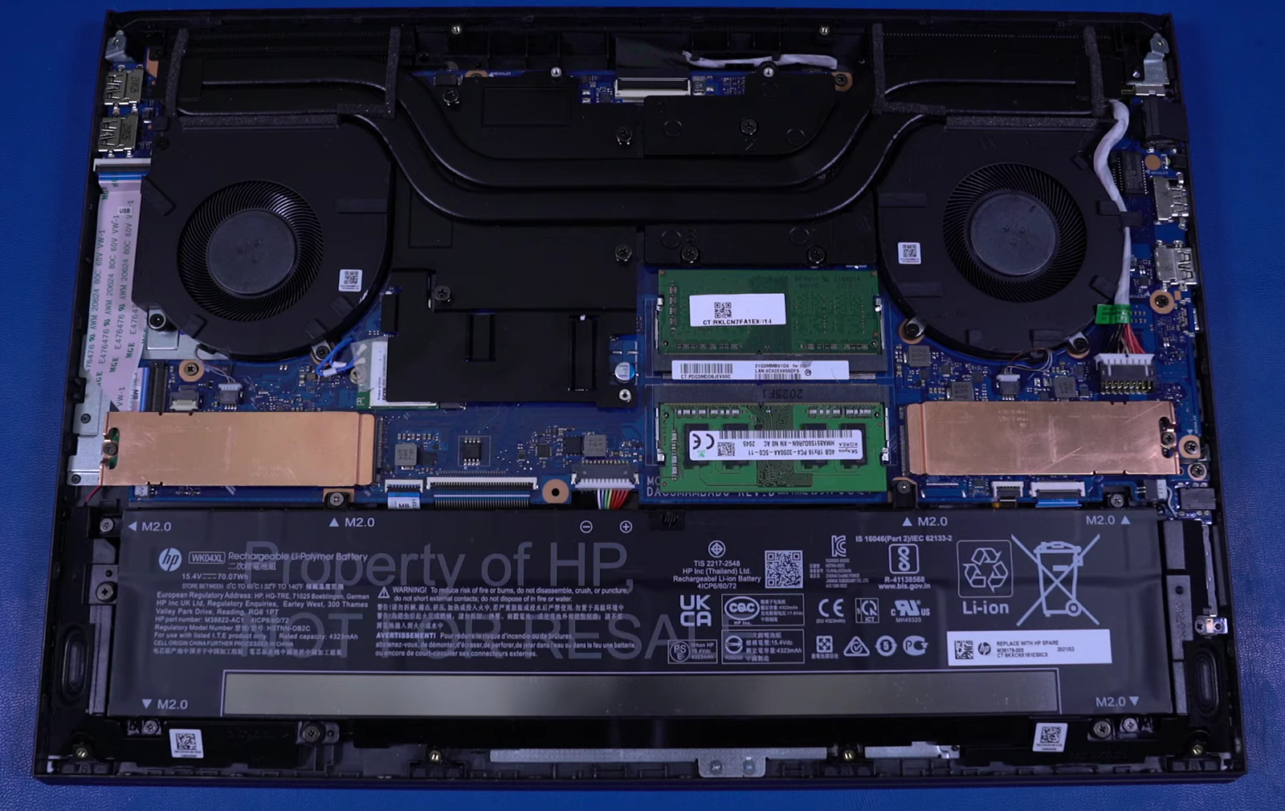
Task:
My laptop is HP VICTUS, Processor: AMD Ryzen 7 6000H, 8 Cores, 16 Logical Processors, NVIDIA GeForce RTX 3060
Heat Spreader, underneath which is the CPU and GPU
Memory Module, 8GB(x2)
Heat Sink
CPU Cooling Fan
GPU Cooling Fan
USB Port
Solid State Drive (512GB)
Wireless LAN Module
70 WH Lithium Battery
Task:
Gavranovic, S., Hartmann, D. and Wever, U., 2019. Topology optimization using gpgpu. Advances in Evolutionary and Deterministic Methods for Design, Optimization and Control in Engineering and Sciences, pp.553-566.
A graphics processing units (GPUs) accelerated adjoint-based optimization platform is proposed in this paper. The reason I was interested in this was because I had previously worked on topology optimization, specifically on computational fluid dynamics with regards to a heat exchanger as a research project. The main issue we faced was the large number of simultaneous equations being computed by the solver. Using GPUs will surely help get desired results in a less computationally expensive way. In the above paper, a two-dimensional adjoint Euler solver is extended to incorporate GPU acceleration using CUDA kernels and named ADjoint-GARfield (ADGAR). The adjoint optimization platform, ADGAR, is verified to a high accuracy of 14 significant digits. Significant speedup of around 16x is observed using ADGAR for computations on a single GPU over a single CPU core.
Alap Mundayoor, M.N. 23351429, IdM: ow07ysym

